Slide 1

No text alternative
There is no alt text for this image.
A11y automated checker | MS Accessibility checker
Detected | Detected

Slide 2

AI-generated text alternative
MS Word guessed the text alternative as “A black background with white text. AI-generated content may be incorrect.”
A11y automated checker | MS Accessibility checker
Not Detected | Detected

Slide 3
Should be decorative
This decorative non-text content should be marked decorative, but it has a text alternative instead.
A11y automated checker | MS Accessibility checker
Not Detected | Not Detected

Slide 4
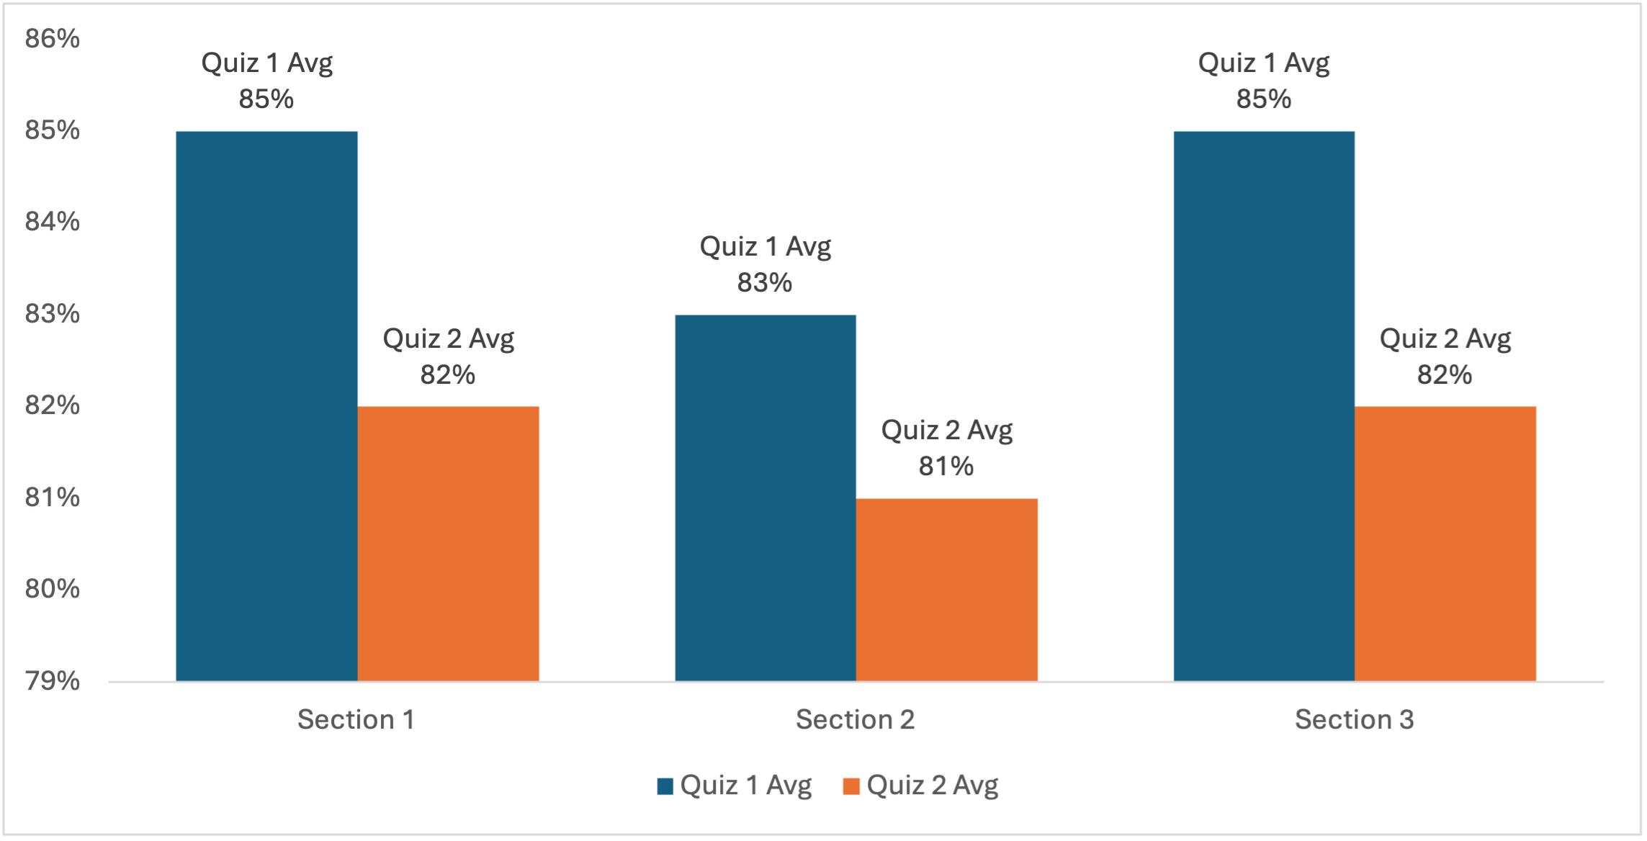
Poorly constructed text alternative: vague
The text alternative here just reads “quiz averages.”
A11y automated checker | MS Accessibility checker
Not Detected | Not Detected

Slide 5
Dense alt text
The text alternative here just reads “Grouped bar graph comparing Quiz 1 and Quiz 2 averages across three sections. Section 1: 85% and 82%. Section 2: 83% and 81%. Section 3: 85% and 82%.”
A11y automated checker | MS Accessibility checker
Not Detected | Not Detected

Slide 6

Poorly constructed text alternative: inaccurate
The text alternative here is just the file name “RSUNJ_H_RED_BLACK_RGB.png.”
A11y automated checker | MS Accessibility checker
Detected | Detected

Slide 7
Poorly constructed text alternative: gibberish
The text alternative here is just the file name “asldkfjasdlfkj.”
A11y automated checker | MS Accessibility checker
Not Detected | Not Detected

Slide 8
Poorly constructed text alternative: placeholder
The text alternative here is just the file name “image.”
A11y automated checker | MS Accessibility checker
Not Detected | Not Detected

